Slide 1

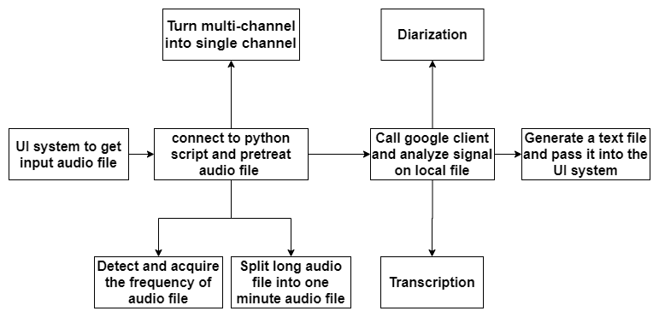
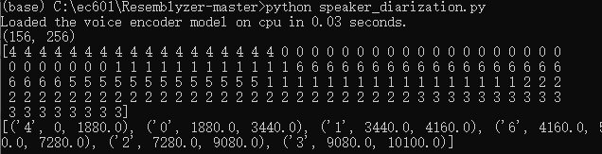
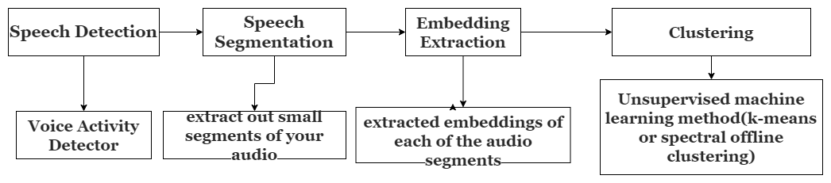
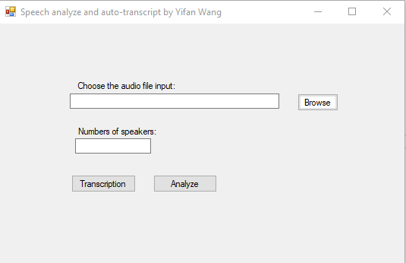
Combination of Speaker diarization and speech recognition for one channel audio records
Yiwei Zhang, Yifan Wang
Introduction
System diagram
Results
Focus: Help someone to analyze audio records of dual people conversation.
Help student to learn from Lecture records
Help the video worker to add subtitles that match the speaker who is speaking
Goal: A tool used for implementing speech- to-text attach speaker identification feature.
Combination of resemblyzer and spectralcluster library
Reasons:
Our model is not trained enough, it will be retrained using more dataset to improve accuracy.
The characteristic the model extract is not good enough to distinct voice.
Next Step
Without API:
1. We need to retrained our model to get high accuracy.
2. Search more advanced algorithm and characteristic of signal to identify voice.
With google API:
1. We need to design timer shaft to embed our text output into audio file.
2. Make different language version or do the translation.
The result of google API is much more accurate than last one. It will distinct two speaker in the conversation.
Method diagram
Visual Studio UI system
System Components
Python
Google Speech-to Text API
Visual Studio
C#

